Slide 1
Interreg-IPA Cross-border Cooperation Romania-Serbia Programme
REPORTING TO
First Level Control Unit

Slide 2
Purpose of the verification
The first level control will verify the compliance with
the rules referring to the following issues:
Sound financial management;
Public procurement;
Double financing;
Publicity rules;
Compliance with the requirements about equality between men and women and non-discrimination, verification based on comparison of the Partner progress report with the Application Form;
Sustainable development, verification based on comparison of the Partner progress report with the Application Form;
Conflict of interest and any suspicion of fraud.

Slide 3
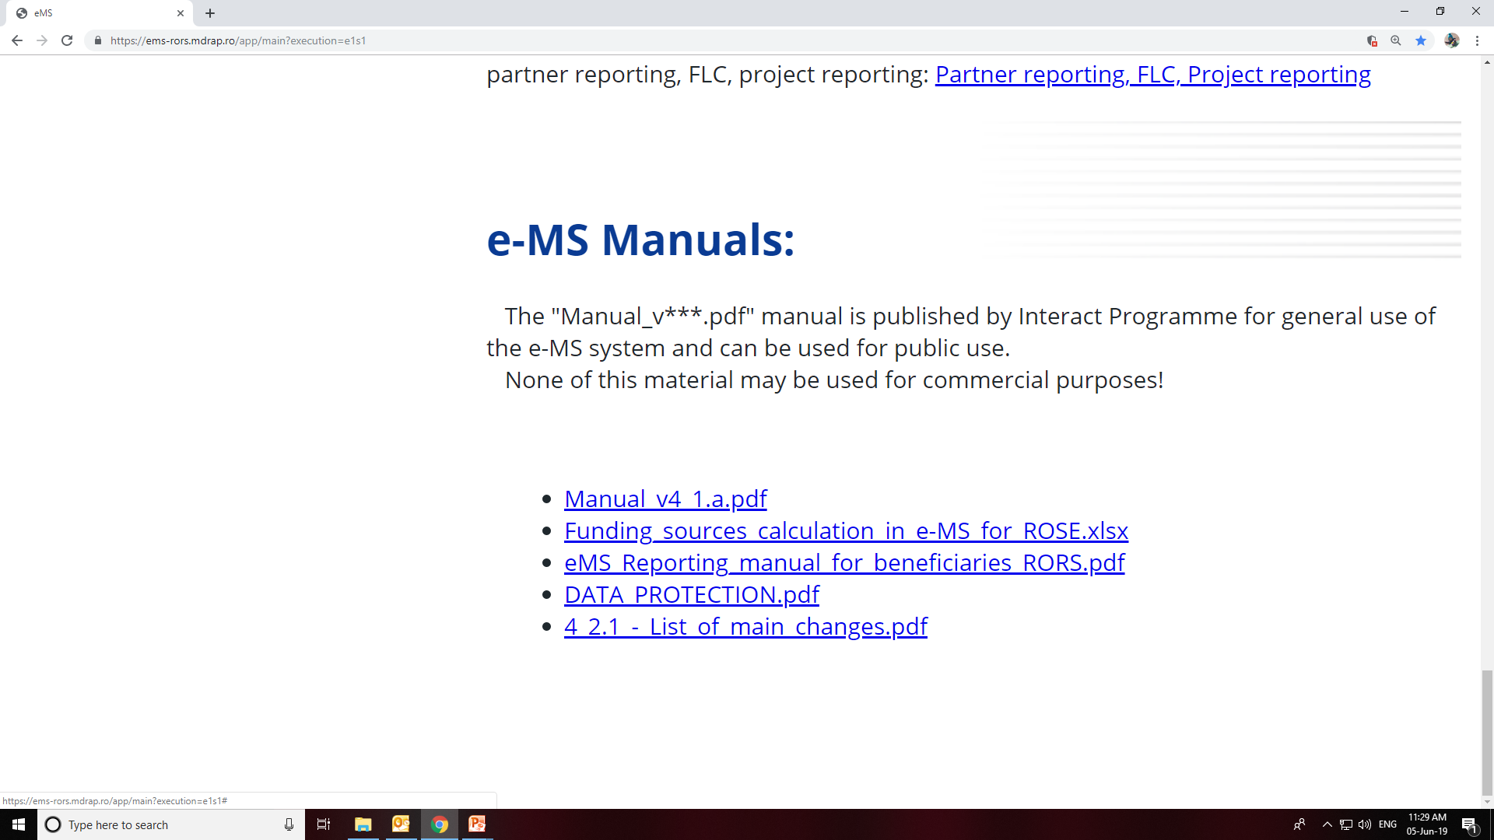
GENERAL PRINCIPLES OF REPORTING:
The general reporting process in e-MS is presented in Reporting Manual and also at the following link:
https://www.youtube.com/playlist?list=PLvYGVfGv4leEn2QC4ztZAFAwlCQztWGyY

Slide 4
Preparation of supporting documents for control:
Before uploading the scanned supporting documents in e-MS, the project beneficiaries shall stamp the original documents with:
Submission of project documentation for control:
The PB/LB submits through e-MS the electronic version of the Partner Report and the corresponding supporting documents;
Desk-check and on-the-spot check by FLC:
Each national controller performs the first level control in the e-MS and the verification shall cover every single cost item;
FLC may ask for additional information;
The controllers are responsible for conducting of on-the-spot checks to 100% of all PB’s at least once during the total project life cycle.
Interreg-IPA CBC Romania-Serbia Programme
Rors: ………
Requested amount: ………€
FLC no.: ………

Slide 5
Expenditure Validation by FLC:
FLC validates the eligible expenditure in e-MS and generate the FLC Report, FLC checklist and FLC Certificate.
Consolidated Progress Report and Reimbursement Claim:
7
Project Beneficiary (PB)
Lead Beneficiary (LB)
3
6
1
2
4
First Level Control (FLC)
Joint Secretariat (JS)
Managing Authority (MA)
5

Slide 6
Some general advice applies for all reporting
Write the reports in a way that is understandable also for people outside your specific field of expertise;
Be truthful and honest in the explanations.
Make references to the project plan and make sure that your activities are in line with the set objectives.

Slide 7
Advice
At least one report is done for each reporting period.
In some cases the period may be shorter than the full 3 months.
NB: In case a partner created and submitted one or more reports before the end of the reporting period, it should create another partner report covering the remaining part of the reporting period for progress of activities.

Slide 8
Partner report
List of expenditure (LoE)
Attachments
Project procurements attachment
Each partner report refers to just one partner and one reference period. This section focuses on activities implemented throughout the reporting period. It contains general descriptions of activities as well as reporting of progress for purchasing main equipment / services / works related to the respective activity.
Financial reporting = List of Expenditure (LoE) section (only for partner reports with expenditure).
Any other attachments that you find relevant for the report, but aren’t yet added as supporting documents for an invoice or proof of delivery of an output, can be added in the Attachment section.
The complete tender dossier must be uploaded at this section and link it to the corresponding invoice.
Partner and period are determined by the partner report itself (each report refers to just one partner and one period of time). Activity + budget line must be selected for every item added.

Slide 9
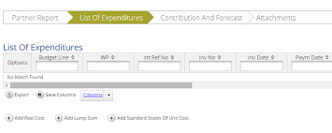
Advice
For each reported expenditure the following supporting documents should be attached:
Staff costs - upload section: payrolls and documents proving the payment (net salary, contributions, other taxes);
Travel and accommodations costs - upload section: travel order, transport invoice, fuel receipt, hotel bills, road/bridge/ferry tax and proof of payment (receipts, payment order, statement of account, cash register);
External expertise and services - upload section: invoice, proof of payment (payment order, statement of account) documents related to reception and acceptance;
Equipment expenditure - upload section: invoice and proof of payment (payment order, statement of account) documents related to reception and acceptance;
Infrastructure and works - upload section: invoice and proof of payment (payment order, statement of account), documents related to reception and acceptance;

Slide 10
Some general advice applies for all reporting
The entire procurement documentation shall be uploaded in the upload section of each procurement contract (Project procurements):
Procurement files (tender dossier, announcement, bids from tenderers, evaluation reports, award documents, all relevant documents related to this procurement …).
Once a link is created, and you will request for FLC verification invoices related to a procurement, the list of invoices for each procurement shall be populated.
NB: Recording all the procurements above 2.500 EUR of the project is compulsory! In case you don’t create procurements in this section, you won’t be able to link the invoice to the procurement when you request it for FLC verification and your FLC request (partner report) may be reverted!

Slide 11
Some general advice applies for all reporting
It is mandatory to create the budgetary line “Office and administration” for each partner report and to claim the corresponding 5% (as set in the subsidy contract) from the direct costs included in the report!
Please note that in order to be identified and verified in the system, the beneficiaries must create separate archive (.zip, .rar) before uploading for each category of expenditures (e.g. one archive for Travel and accommodation, one for External expertise and services, one for Equipment expenditure and one for Infrastructure and works).
The files attached to these archives will be named in English in accordance with the relevant content of documents (e.g.: agenda of the seminar/event/conference held at/on …) Also, in the comment section, the beneficiaries must specify the budget line to which the archive is linked to.
In case the supporting documents are not properly named and/or uploaded without being linked to the corresponding budget line, the FLC controller/ MA may return the whole report to the partner for revision.

Slide 12
Use of standard documents:
4
Imposed by the Programme;
Imposed by the National legislation;
Basic rules
All payments incurred by the project will be made from the project’s designated accounts.
x
To identify all expenses incurred for the project, a separate accounting record will be kept on distinct analytical accounts.
Termination clause

Slide 13
Thank you for your attention!

